Slide 1




Angular, React and Vue

Slide 2

Agenda
What is Angular
What is React
What is Vue
Angular Features
React Features
Comparison

Slide 3
What is Angular?

Slide 4
Standard Web App (static)
Web Server
Web Browser
URL Request to server
Response with Webpage & Assets
HTML
Java
Script
User clicks on link, new Request
HTML
Java
Script
Response with Webpage & Assets

Slide 5
Angular Web App (SPA)
Web Server
Web Browser
URL Request to server
Response with Webpage & Assets
HTML template
User clicks on link, new Request
*Events binding*
Component
Response with JSON data
TypeSctipt definition

Slide 6
SPA is really just one index.html with css and js bundles

Slide 7
Why SPA IS awesome?

Slide 8
Why SPA IS NOT awesome?

Slide 9
Back to Angular: everything about SPA is also about the framework

Slide 10

History
Angular JS – framework for
single page web apps
MVC
Release – 2010
MIT license
TDD and BDD friendly
DOM-management separated from app logic
Client and server decoupled to two different apps

Slide 11

Actual
Angular 2+ – ground up rewrite
of angularjs
Release – 2016
TypeScript

Slide 12
What is TypeScript?
This is a super set of JS. Shortly it gives more features that vanilla JS (e.g. Types, Classes, Interfaces). Especially strong typing. In JS you can have a string variable and than assign to it a number value and that’s totally fine. For TS – that’s not. TypeScript has a compiler and TS compiler will throw an error in mentioned case due to type mismatching.
TypeScript doesn’t run in the browser. It is compiled to JS. And this bunch of JS code will change the DOM of our SPA.
This compilation is handled by CLI.

Slide 13
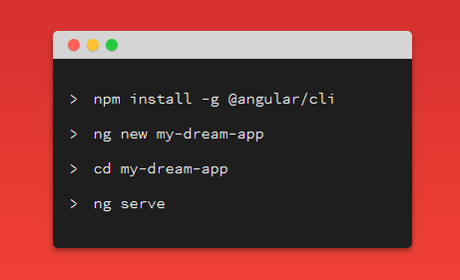
What is a CLI?
CLI - a command line interface, just a project management tool.

Slide 14
To Do
Preparation:
Open a terminal
Run ng help to get acquainted with CLI commands. They have a small description.
Create a project:
1. Run:
> npm install -g @angular/cli
> ng new playground
> cd playground
> ng serve -o
2. localhost:4200 should be opened if not – open by yourself to verify project intiallization

Slide 15
Dive in. How an Angular App gets loaded and started?

Slide 16
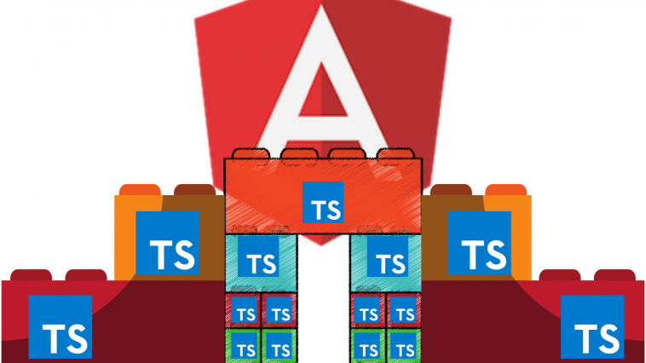
Dive in: Modules

Slide 17
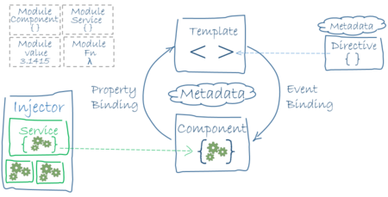
Dive in: Components
There are 2 main characters: Component (TS definition), Template (HTML definition)
Angular binds Components and Templates

Slide 18
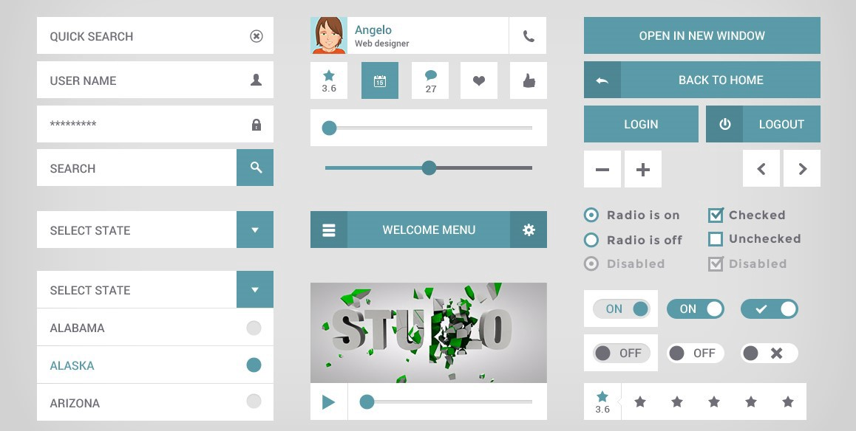
Components:

Slide 19
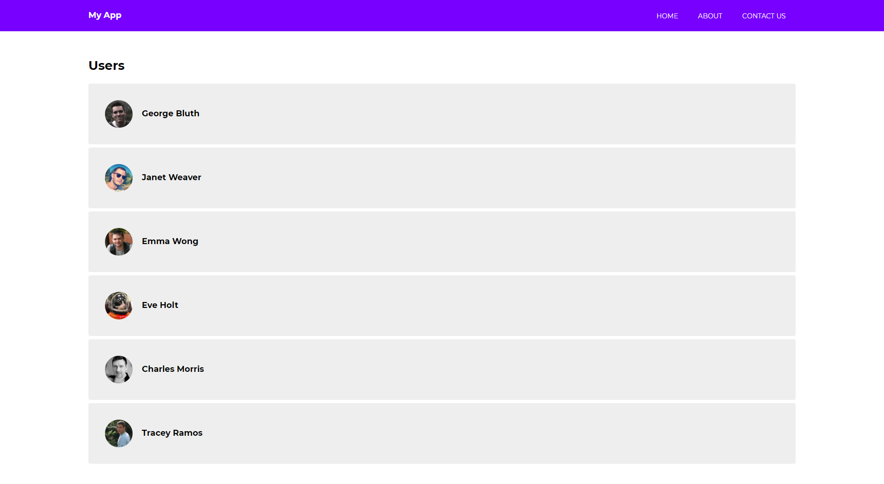
Nav Component
Home Component

Slide 20
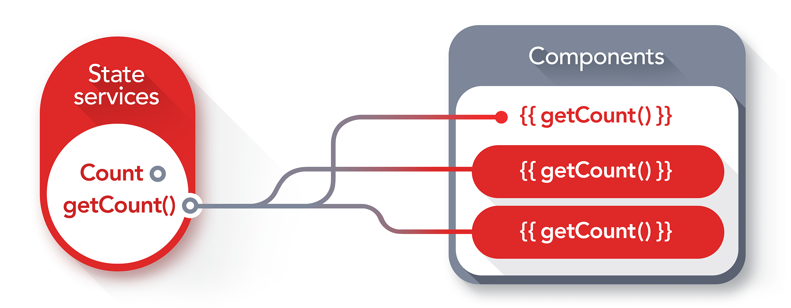
Dive in: Services

Slide 21
Data Binding

Slide 22
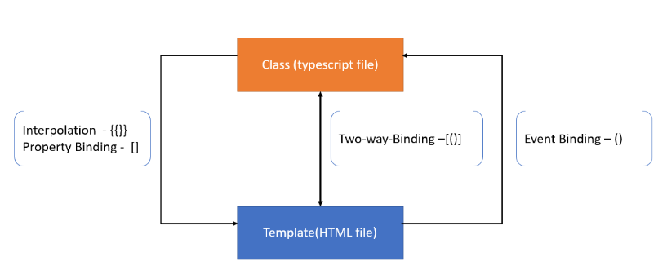
One way and two – way binding

Slide 23
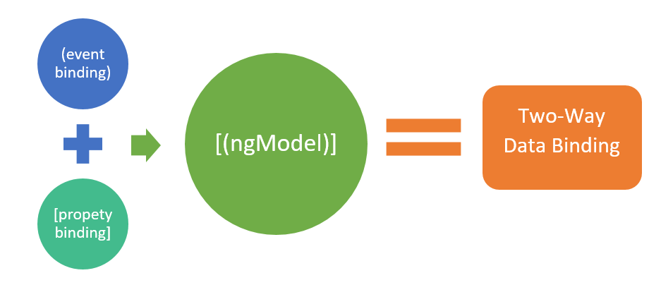
Two way binding

Slide 24
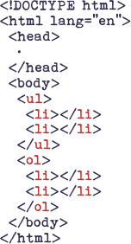
Directives
Vanilla html

Slide 25
Directives - structural directives
*ngIf – checks boolean parameter and adds template
<div *ngIf="hero" class="name">{{hero.name}}</div>
*ngFor – loops component over array of data
<div *ngIf="hero" class="name">{{hero.name}}</div> <ul> <li *ngFor="let hero of heroes">{{hero.name}}</li> </ul>

Slide 26
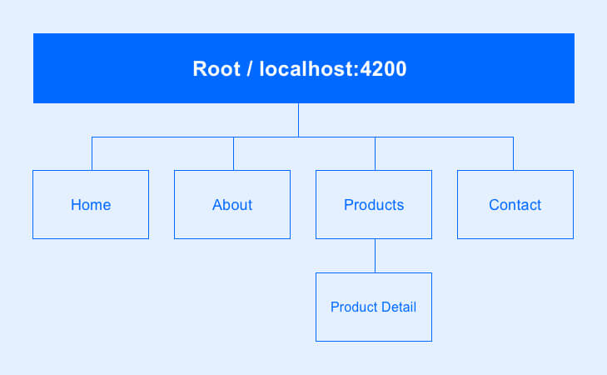
Router

Slide 27
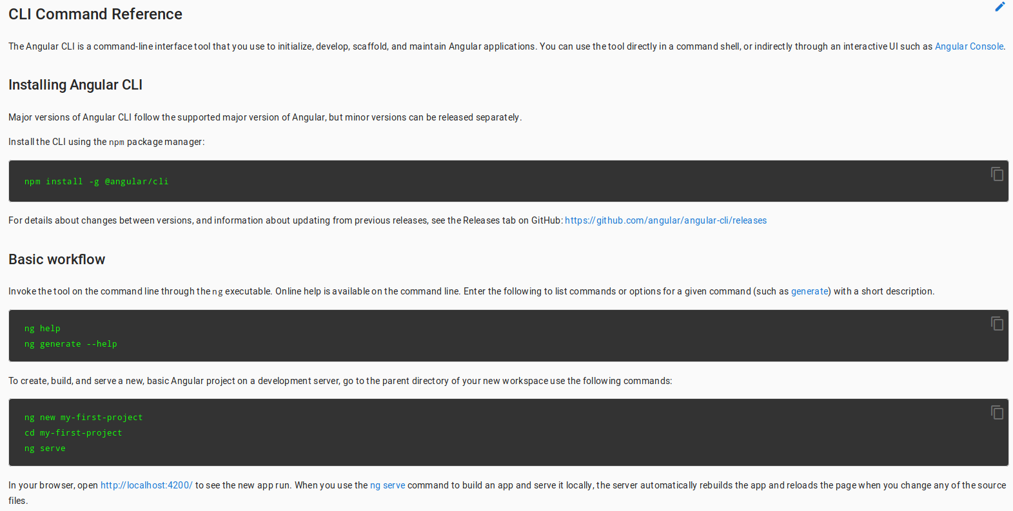
Angular CLI
Notes:
AngularJS представляет собой комплексный фреймворк. В стандартной поставке он предоставляет следующие возможности:
Все, что вам нужно для создания CRUD-приложений: data-binding, базовые директивы для шаблонов, валидация форм, роутинг, deep linking, повторное использование компонентов, dependency injection, инструменты для взаимодействия с серверными (RESTful) источниками данных.
Все, что вам нужно для тестирования: средства для модульного тестирование, end-to-end тестирования, mock-и.
Шаблон типового приложения, включающего в себя структуру каталогов и тестовые скрипты.

Slide 28
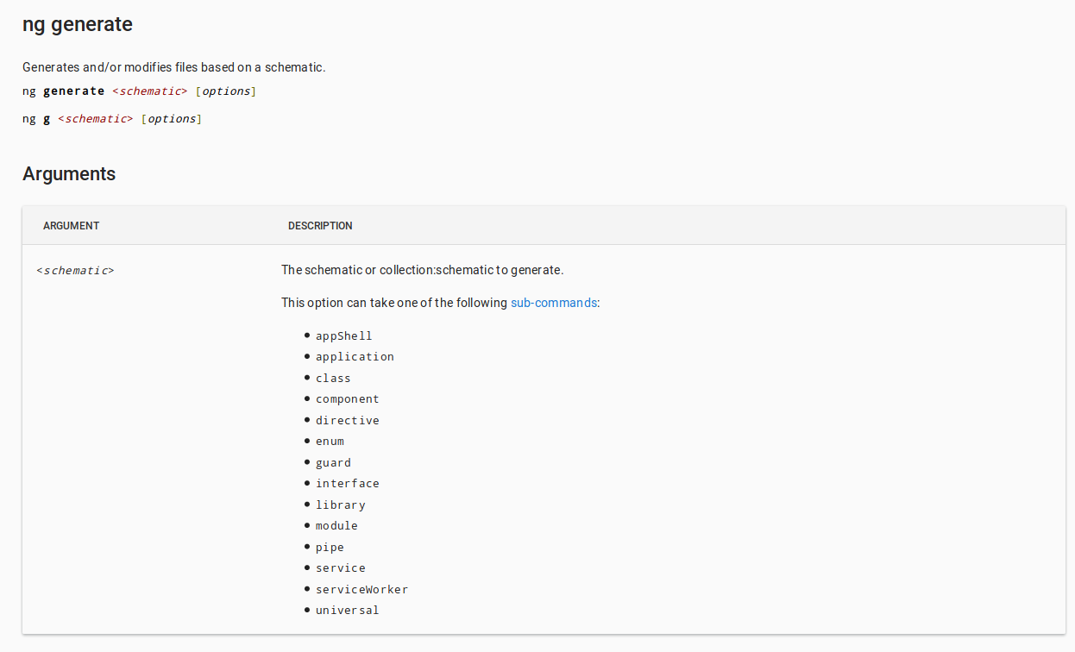
ng generate
Notes:
Хорошо отделять манипуляцию DOM-ом от логики работы приложения. Это существенно улучшает тестируемость кода.
Хорошо считать, что автоматизированное тестирование приложения настолько же важно, насколько и написание самого приложения. Тестируемость очень сильно зависит от того, как структурирован код.
Хорошо отделять разработку клиентской части от серверной. Это позволяет вести разработку параллельно и улучшает повторное использование на обеих сторонах.
Хорошо, когда фреймворк ведет разработчика по всему циклу разработки приложения: от проектирования UI через написание бизнес-логики к тестированию.
Хорошо, когда распространенные задачи становятся тривиальными, а сложные — упрощаются.

Slide 29
What is REACT?

Slide 30
Why is REACT?
Components, no Spaghetti
JSX
Virtual DOM
Server Side Rendering
JavaScript
Also TypeScript
Release 2013

Slide 31
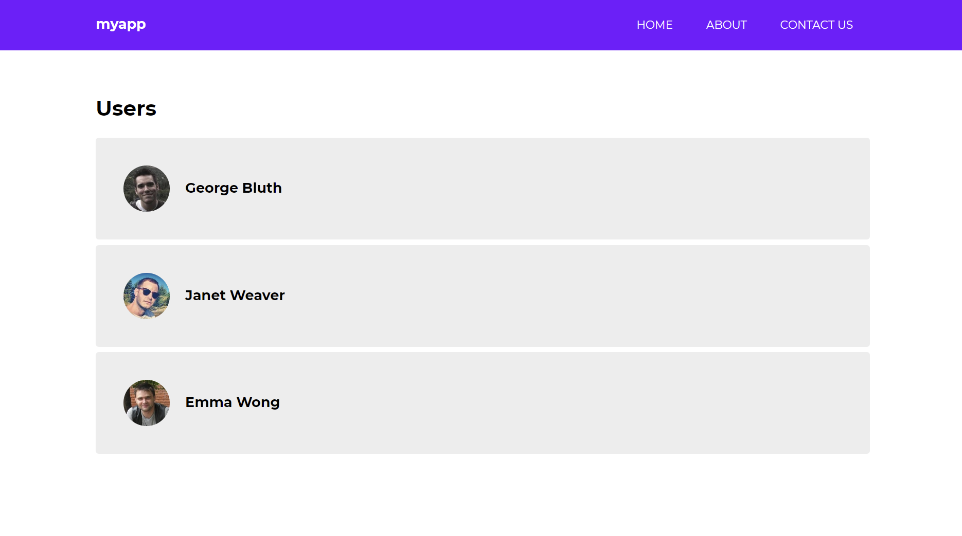
Find components here

Slide 32
Simple example
<!DOCTYPE html>
<html>
<head>
<meta charset="utf-8"/>
<title>Hello React!</title>
<script src="https://unpkg.com/react@16/umd/react.development.js"></script>
<script src="https://unpkg.com/react-dom@16/umd/react-dom.development.js"></script>
<script src="https://unpkg.com/babel-standalone@6.26.0/babel.js"></script>
</head>
<body>
<div id="root"></div>
<script type="text/babel">
class App extends React.Component {
render() {
return <h1>Hello world!</h1>
}
}
ReactDOM.render(<App/>, document.getElementById('root'))
</script>
</body>
</html>

Slide 33
Rendering elements
<div id="root"></div>
index.html
function tick() {
const element = (
<div>
<h1>Hello, world!</h1>
<h2>It is {new Date().toLocaleTimeString()}.</h2>
</div>
);
ReactDOM.render(element, document.getElementById('root'));
}
setInterval(tick, 1000);
app.jsx

Slide 34
Components
Functional Component:
function Welcome(props) {
return <h1>Hello {props.name}!</h1>;
}
Class Component:
class Welcome extends React.Component {
render() {
return <h1>Hello {this.props.name}</h1>;
}
}

Slide 35
Props
function Welcome(props) {
return <h1>Hello {props.name}!</h1>;
}
function App() {
return (
<div>
<Welcome name="Students" />
<Welcome name="Max" />
<Welcome name="Luda" />
<Welcome name="World" />
</div>
);
}
ReactDOM.render(
<App />,
document.getElementById('root')
);
app.jsx

Slide 36
State
class Welcome extends React.Component {
constructor(props) {
super(props);
this.state = {color: 'black'}
}
componentDidMount() {
this.timerID = setInterval(
() => this.changeColor(),
1000
);
}
componentWillUnmount() {
clearInterval(this.timerID);
}
changeColor() {
this.setState({
color: '#' + Math.floor(Math.random()*16777215).toString(16)
});
}
render() {
return (
<h1 style={{color: this.state.color}}>Hello {this.props.name}!</h1>
);
}
}

Slide 37
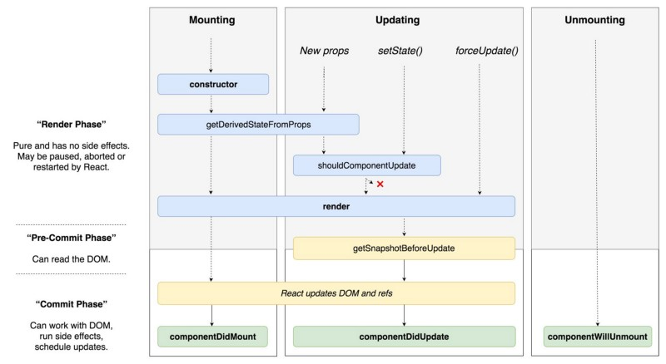
Lifecycle
https://habr.com/ru/post/358090/

Slide 38
Handling events
class Welcome extends React.Component {
constructor(props) {
super(props);
this.state = {color: 'black'}
}
handleClick = () => {
this.setState({
color: '#' + Math.floor(Math.random() * 16777215).toString(16)
});
};
render() {
return (
<>
<button onClick={this.handleClick}>Change color</button>
<h1 style={{color: this.state.color}}>Hello {this.props.name}!</h1>
</>
);
}
}
class App extends React.Component {
render() {
return (
<Welcome name="World"/>
);
}
}

Slide 39
More to read
Node.js
npm
Babel
Next.js
Webpack
Css modules

Slide 40
Vue.JS

Slide 41
Overview
Vue.js is pretty simple in comparison to Angular and React. It’s based on components too, it uses directives and virtual DOM but an entry barrier is smaller than already overviewed frameworks. Let’s get familiar with it!

Slide 42
Installation
Installation process is very simple: just add script tag to html template body with reference to Vue.js through CDN.
<script src="https://cdn.jsdelivr.net/npm/vue/dist/vue.js"></script>
Create index.html and add to this code:
<html>
<head>
<link rel="stylesheet" href="index.css">
<script src="https://cdn.jsdelivr.net/npm/vue/dist/vue.js"></script>
</head>
<body>
<script src="index.js"></script>
</body>
</html>
Also create in the same directory index.js.

Slide 43
Fill with the following code
<html>
<head>
<link rel="stylesheet" href="index.css">
<script src="https://cdn.jsdelivr.net/npm/vue/dist/vue.js"></script>
</head>
<body>
<div id="app">
{{ message }}
</div>
<script src="index.js"></script>
</body>
</html>
Add to index.html this:
Add to index.js this:
Declare div,
add to it id, use interpolation
syntax to make possible
dynamic value changing
between <div>s
var app = new Vue({
el: '#app',
data: {
message: 'Hello Max'
}
})
Create variable, assign
to it Vue instance and pass
in it
an options object (
element for binding
and some data)

Slide 44
Open index.html in browser directly

Slide 45
Directives
Vue uses Directives to control DOM behavior. As in Angular, Directives are declared directly in tags as html attributes. For example, if – directive with already known mechanic. It’s defined by the following in Vue.js: v-if
Let’s add it to our hello-world app. Create a new variable in index.js by this way:
Add this snippet into body-tag:
Save all changes and reload index.html page in a browser.
var app2 = new Vue({
el: '#app-2',
data: {
seen: true
}
})
<div id="app-2" v-if="seen">
Hello Java School!
</div>

Slide 46
Components
Vue is also based on components. In Vue, a component is essentially a Vue instance with pre-defined options. Registering a component in Vue is straightforward, just add this at the top of index.js:
In index.html replace internals of div block with id “app-2” with the following code:
Save and reload the page.
Vue.component('java-school', {
template: '<p>This is a Java School</p>'
})
<div id="app-2" v-if="seen">
<java-school></java-school>
</div>

Slide 47
Finish
Final code should look like this:
index.html index.js
<html>
<head>
<link rel="stylesheet" href="index.css">
<script src="https://cdn.jsdelivr.net/npm/vue/dist/vue.js"></script>
</head>
<body>
<div id="app">
{{ message }}
</div> <div id="app-2" v-if="seen">
<java-school></java-school>
</div>
<div>
</div>
<script src="index.js"></script>
</body>
</html>
Vue.component('java-school', {
template: '<p>This is a Java School</p>'
})
var app = new Vue({
el: '#app',
data: {
message: 'Hello Max'
}
})
var app2 = new Vue({
el: '#app-2',
data: {
seen: true
}
})

Slide 48
Frameworks Comparison
Result | Angular | Vue.js | React
Easy to start | - | + | +
Components | + | + | +
Documentation | + | + | +
Directives | + | + | ?
Virtual DOM | - | + | +
TypeScript | + | + | +
CLI | + | + | ?
Angular as a framework has a lot of build-in features and there are no need to add a huge number of dependencies with libraries. But as a framework Angular is also heavy and dictates how to write an app. Vue.js is the lightest flexible solution but in case of big projects its flexibility becomes a problem and Angular with its imperative style can be a better choice here.

Slide 49

THANK YOU!

